Slide 1
The Kentucky Department of Revenue presented the following information at the annual 2019 KyCPA State Tax Conference on December 5, 2019. This presentation covered a basic overview of recent statute and regulation changes as well as changes to the regulation promulgation process.
The information in this presentation was prepared from information the Department of Revenue possessed and believed to be accurate and relevant on the date of the meeting. This information does not constitute a final ruling, order, or determination of the Department of Revenue and cannot be appealed.

Slide 2
State Tax Conference
Kentucky Society of CPAs
Presentation Date: December 5, 2019
Kentucky Department of Revenue • 501 High Street • Frankfort, KY 40601 • (502) 564-4581

Slide 3
Introduction
Daniel P. Bork, CPA
Commissioner
Kentucky Department of Revenue

Slide 4
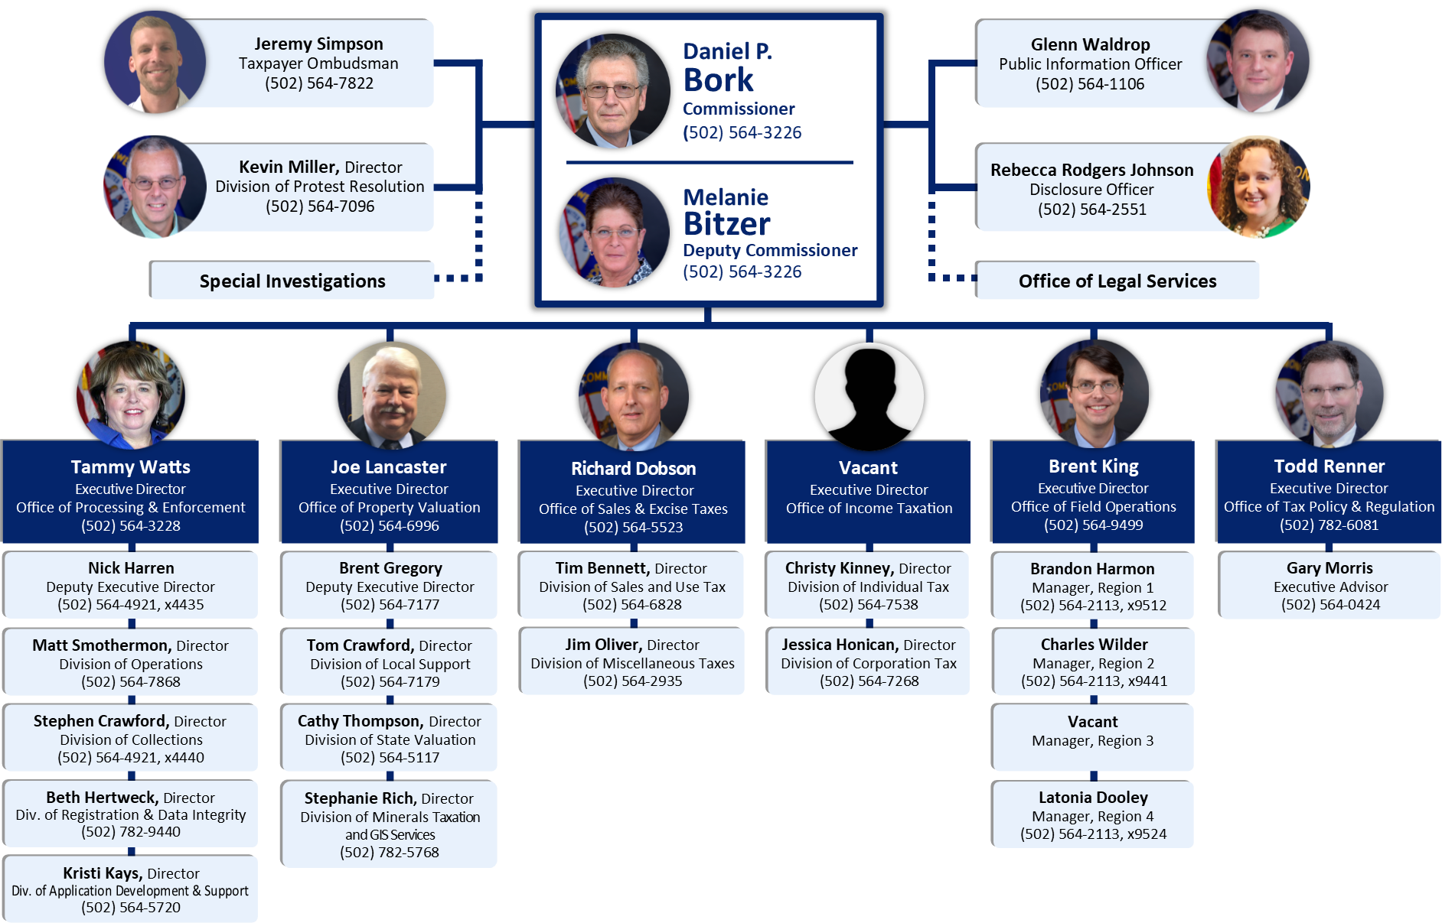

Slide 5
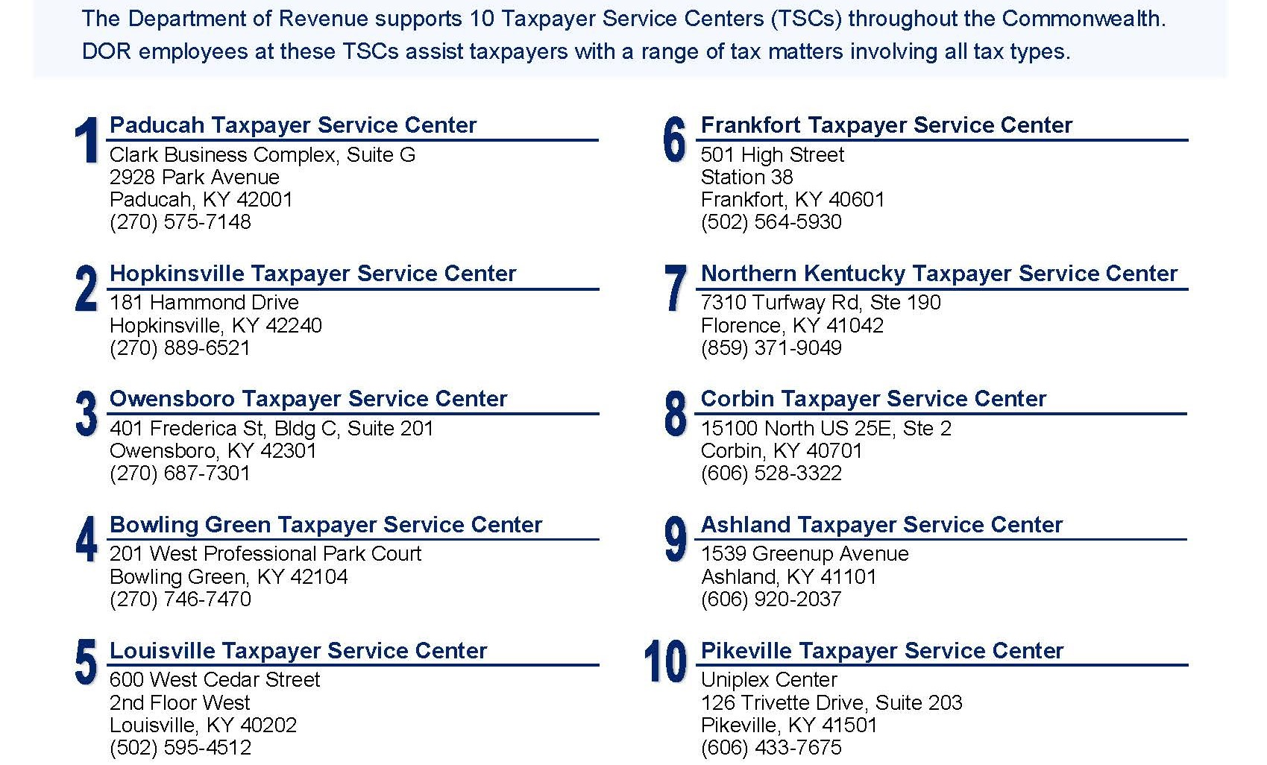
Taxpayer Service Centers

Slide 6
Outside Organizations
Federation of Tax Administrators (FTA)
Southeast Association of Tax Administrators (SEATA)
Streamlined Sales Tax Governing Board (SSUTA)
Multistate Tax Commission (MTC)

Slide 7
Major KDOR Initiatives
Integrated Tax System (ITS)
Moves KDOR from 150+ applications to 1 system
Will allow taxpayer account access online
“One Department One Team”
Culture shift away from “silo” mentality
More consistent responses from all KDOR areas
Tax Guidance
KRS 131.130(8) allows KDOR to issue non-binding guidance setting forth its interpretation of statutes and regulations

Slide 8
Emerging Tax Issues
Vaping
Marijuana
Sports Betting
Historical Racing
Software-as-a-Service
Wayfair and Corporate Tax Nexus
Cryptocurrencies

Slide 9
Sales Tax Updates
Richard Dobson
Executive Director
Office of Sales & Excise Taxes

Slide 10
Sales Tax Changes – HB 354 Highlights
Resale for the Sale or Purchase of Certain Services —
For transactions on or after July 1, 2019, a retailer may claim a resale exemption for the purchase and resale of the services that became subject to sales tax as of July 1, 2018 (HB 487). Unless otherwise specified in statute, the resale exemption applies only to those services in subsections (g) through (q) of KRS 139.200 listed below:
Landscaping services;
Janitorial services;
Small animal veterinary services;
Pet care services;
Industrial laundry services;
Non-coin-operated laundry and dry cleaning services;
Linen supply services;
Indoor skin tanning services;
Non-medical diet and weight reducing services;
Limousine services, if a driver is provided; and
Extended warranty services to cover tangible personal property or digital property that is taxable at retail to the warranty holder.
If a retailer purchases any of the services listed above for the purpose of reselling those services to a customer, the retail purchaser may issue a resale certificate and not pay the 6% sales tax at the time of purchase. The purchaser must fully
complete the resale certificate, Form 51A105 or Streamlined Sales and Use Tax Agreement Certificate of Exemption,
Form 51A260, and issue it to the service provider within 90 days of the sale in accordance with KRS 139.270. The retail purchaser will then collect the 6% sales tax on the services when resold to the final customer.

Slide 11
Wayfair Update
Economic Nexus Provisions
- November 2018
24 states (including KY) & D.C.
- November 2019
All sales tax states except MO & FL
Marketplace Provider / Facilitator
- November 2018
7 states (MD, MN, NJ, OK, PA, RI, WA)
- November 2019
38 states & D.C.
Marketplace Providers – HB 354 requires these online sales platforms to collect and remit KY sales and use tax on transactions they facilitate for sales into the Commonwealth from third party sellers. Collection requirements apply based upon the economic nexus standard of more than $100,000 in gross receipts or 200 or more transactions from sales into KY annually. This threshold is the same as adopted in 2018 for remote retailers in HB 487 post Wayfair. Effective July 1, 2019.

Slide 12
Toller Qualification for Energy Direct Pay
Reverses the exclusion in HB 487 for tolling operations at KY plant facilities and establishes objective criteria to determine whether such operations are eligible for the partial EDP sales tax exemption for energy purchases.
Effective June 27, 2019.
Manufacturers and industrial processors with tolling operations in place as of July 1, 2018 with approved Energy Direct Pay Authorizations may continue to benefit from the partial exemption to the extent their energy purchasing thresholds allow.
For manufacturers and industrial processors that begin tolling and seek to qualify for the partial energy exemption for periods on or after July 1, 2018, HB 354 establishes specific criteria the Department will use to determine whether an applicant meets the required cost of production thresholds. For the Department to consider the impact of tolling operations to the cost of production at the plant facility, the applicant for the Energy Direct Pay Authorization must:
Maintain a binding contract with the legal entity that holds title to the material that becomes part of the product of the manufacturing or industrial processing activity;
Maintain accounting records of expenses incurred fulfilling this contract;
Maintain records that demonstrate its independent operation in performance of its tolling operations;
Demonstrate one or more substantial business purposes for the tolling operation other than the lowering of its sales tax liability on energy purchases; and,
Provide documentation the Department deems necessary to substantiate requirements 1 through 4 along with an explanation of how the tolling operation relates to other operations within the plant facility.

Slide 13
Video Streaming Service Providers
The definition of multichannel video programming service includes video streaming services for the Utility Gross Receipts License Tax and the Kentucky Telecommunications Tax. As amended, KRS 136.602 (8) defines a “multi-channel video programming service” as, “…live, scheduled, or on-demand programming provided by or generally considered comparable or in competition with programming provided by a television broadcast station and shall include but not be limited to:
(a) Cable service;
(b) Satellite broadcast and wireless cable service;
(c) Internet protocol television provided through wireline facilities without regard to delivery technology; and
(d) Video streaming services.”
“Video streaming services” means “programming that streams live events, movies, syndicated and television programming, or other audio-visual content over the Internet for viewing on a television or other electronic device with or without regard to a particular viewing schedule.”

Slide 14
Video Streaming Service Providers
Applicable Tax Rates and Base
Video streaming services provided to Kentucky customers are subject to the 3% excise tax (KRS 136.604) and the 2.4% gross revenues tax (KRS 136.616) (KY telecommunications taxes) as well as the school tax imposed at a local school district rate not to exceed 3% (KRS 160.614) billed on or after July 1, 2019. Furthermore, there is no deduction for the 2.4% gross revenues tax under KRS Chapter 136 from gross receipts subject to the school tax in KRS Chapter 160 since the imposition of the gross revenues tax is not upon the customer. See calculation example below:
Video Streaming Charge: $12.95
3% Telecom Excise Tax: (.03 x $12.95) 0.39
2.4% Gross Revenue Tax: (.024 x $12.95) 0.31
3% UGRLT: (.03 x $12.95 = $0.33) + (.03 x $0.31 = $0.01) 0.34
TOTAL $13.99
Sourcing
Per KRS 136.604 (3) “Providers shall source multichannel video programming services to the end user's place of primary use.”
“Place of Primary Use” is defined under KRS 136.602 as “the street address where the end user's use of the
multichannel video programming service primarily occurs.” To be compliant with this requirement for the school tax,
streaming service providers should allocate gross receipts to the school district in which the customer’s primary street
address is located.

Slide 15
Regulatory Matters
J. Todd Renner, CPA, CGMA
Executive Director
Office of Tax Policy & Regulation

Slide 16
Statutes and Regulations
“Revenue and Taxation” statutes appear in Title XI of the Kentucky Revised Statutes (KRS)
Title XI includes KRS Chapters 131 through 145
General Assembly updates tax statutes annually
Regulations appear in Title 103 of the Kentucky Administrative Regulations (KAR)
KDOR updates KAR through the General Assembly
HB 4 from 2019 significantly increased regulation promulgation timing

Slide 17
New Regulation Process
New Regulation Rules
Regulations must be amended or re-certified every 7 years
General Assembly can review any regulation in committee at any time
LRC will publish a list of regulation deficiencies every December
Governor can retain regulation as written, require agency amendment, or defer to legislature
Legislature can work with agency to amend or void regulation
New Regulation Process
Still filed by 15th of each month
Public comment period extended by one month
Secondary review committee now has 90- not 30-days to review

Slide 18
Regulation Changes
Great collaboration with Chamber, KyCPA, and other industry groups.
KAR updates through October 2019 below.
Effort will continue through year end.
 | Administrative | Income | Miscellaneous* | Sales* | Property | Total
Beginning | 8 | 59 | 36 | 62 | 14 | 179
New | - | 1 | - | 3 | 2 | 6
Repealed | - | (22) | (8) | (4) | (5) | (39)
Ending | 8 | 38 | 28 | 61 | 11 | 146
 | Administrative | Income | Miscellaneous* | Sales* | Property | Total
New | - | 1 | - | 3 | 2 | 6
Amended | 5 | 33 | 10 | 42 | 5 | 95
No Change | 3 | 4 | 18 | 16 | 4 | 45
Total | 8 | 38 | 28 | 61 | 11 | 146

Slide 19
Recent Tax Law Changes
HB 487 from 2018
Move from income to consumption tax
Lowered income tax rates and expanded sales tax base
HB 354 from 2019
Responded to unpopular changes in HB 487
Repealed bank franchise tax
HB 458 from 2019
Provided clarity for unitary groups definitions and NOL sharing

Slide 20
Revenue Guidance Project
Revenue Procedure (RP)
Provides procedural guidance to assist in the administration of laws and regulations by providing direction that may be followed in order to comply with the law.
Technical Advice Memorandum (TAM)
Guidance that applies principles of tax law to a set of facts or general category of taxpayer.
Format: Issue – Facts and Discussion – Law – Conclusion
Private Letter Ruling (PLR)
Issued upon taxpayer request and are based on specific factual situations provided by the taxpayer.
Are publicly available in redacted form after October 1, 2019
General Information Letter (GIL)
Anonymous PLRs hat are no binding on KDOR

Slide 21
Revenue Procedure KY-RP-19-03
Authorized by KRS 131.130(8)
Background information on RPs, TAMs, PLRs, and GILs
Distinguishes regulations from guidance
Guidance does not have the force and effect of law
Defines and provides reasons for issuance or denial
Outlines the process and content requirements for guidance requests
Provides procedures for issuing guidance
2019 revision provides for publication of PLRs and minor updates
Guidance does not constitute a final ruling, order, or determination of KDOR. Therefore, KDOR guidance cannot be appealed to the Kentucky Claims Commission, Tax Appeals, not may a taxpayer file a protest based on issuance of KDOR guidance.

Slide 22
State Tax Conference
Daniel P. Bork, Commissioner
 Dan.Bork@ky.gov
 (502) 564-3226
The information in this presentation is for educational and informational purposes only and does not constitute legal advice. Information is presented as an overall review that is subject to law changes and may not apply to all states. For accurate information on issues related to the Kentucky Department of Revenue, please reference KRS Title XI and KAR Chapter 103.
Information in this presentation is believed to be accurate as of the date of publication. In the event that any information in this presentation is later determined to be in error, this presentation cannot be used by taxpayers in supporting a specific position or issue before the Department of Revenue, as it does not have the statutory or regulatory authority.
Kentucky Department of Revenue
501 High Street • Frankfort, KY 40601
(502) 564-4581

